Slide 1
do while

Slide 2
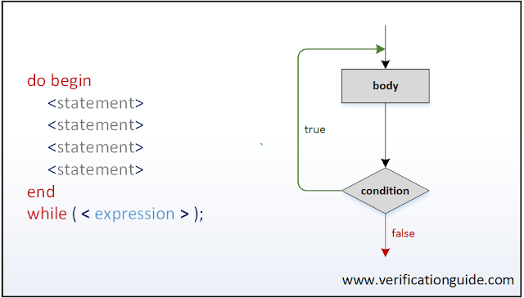

Slide 3
Sample code
module do_while;
int a; // integer would require initial a=0;
initial begin
do
begin :inner_loop
$display(“\tValue of a=%d”,a);
a++;
end :inner_loop
while (a<5); // true? repeat loop/continue
end // false? break
endmodule

